Slide 1

Solving Linear Inverse Problems Using the Prior Implicit in a Denoiser
POUYA IRANI
1937388

Slide 2
Overview
Deep neural networks have provided solutions for problems such as denoising, which implicitly rely on a prior probability model of natural images.
In this project a robust and general methodology for making use of this implicit prior is developed.
We develop a stochastic coarse-to-fine gradient ascent procedure for drawing high-probability samples from the implicit prior embedded within a CNN trained to perform blind (i.e., with unknown noise level) least-squares denoising.
We also develop unsupervised performance for deblurring, super-resolution, inpainting, and compressive sensing.

Slide 3


Slide 4
Review of literature
Traditionally, models have been developed by combining assumed symmetry properties, with simple parametric forms, often within pre-specified transformed coordinate systems but they are too simplistic to generate complex features, or to solve more demanding statistical inference problems.
In recent years, nearly all problems in image processing and computer vision have been revolutionized by the use of deep Convolutional Neural Networks (CNNs). These networks are generally trained to perform tasks in a supervised fashion, without explicit use of an image prior.
Their extraordinary success shows they use more complex priors. These implicit priors come from the training data distribution, network architecture, regularization terms in the optimization objective, and the optimization process. They're also tied to the task they're optimized for.

Slide 5
Contribution of this project
Now in this project we derive a general algorithm for solving linear inverse problems using the prior implicit in a denoiser.
Classical statistics says a denoiser that minimizes squared error of additively distorted pictures is optimal. Gaussian noise is the gradient of noisy pictures' log density. This result is similar to score matching, but it relates least-squares optimum denoising to the embedding prior.
Starting from a random initialization, we develop a stochastic ascent algorithm that uses this denoiser-estimated gradient to draw high-probability samples from the embedded prior. The gradient step sizes and the amplitude of injected noise are jointly and adaptively controlled by the denoiser, producing robust and efficient convergence.
Notes:
More generally, we combine this procedure with constraints arising from any linear measurement of an image to draw samples from the prior conditioned on this measurement, thus providing a stochastic solution for any linear inverse problem. We demonstrate that our method, using the prior implicit in a pre-trained state-of-the-art CNN image denoiser, produces high-quality results on image synthesis, inpainting, super-resolution, deblurring and recovery of missing pixels. We also apply our method to recovering images from projections onto a random low-dimensional basis, demonstrating results that greatly improve on those obtained using sparse union-of-subspace priors typically assumed in the compressive sensing literature. 1

Slide 6
Dataset and Libraries
Dataset :
Inpainting examples generated using three BF-CNN denoisers trained on:
(1) MNIST
(2) Berkeley segmentation dataset: The public benchmark based on this data consists of all of the grayscale and colour segmentations for 300 images. The images are divided into a training set of 200 images, and a test set of 100 images.
Important Libraries:
The most important libraries employed in the code are reported in the following list:
OS:we import the os module to interact with the underlying operating system
Numpy: used to support multidimensional array;
Pandas: flexible and easy to use open source data analysis and manipulation tool
Matplotlib: a comprehensive library for creating static, animated, and interactive visualizations in Python.
Torch : is an open-source machine learning library, a scientific computing framework, and a script language. It provides a wide range of algorithms for deep learning, and uses the scripting language

Slide 7
Methodology
Different Denoisers:
Inpainting
Missing random pixels
Spectral Super resolution
Random basis
Spatial super resolution

Slide 8
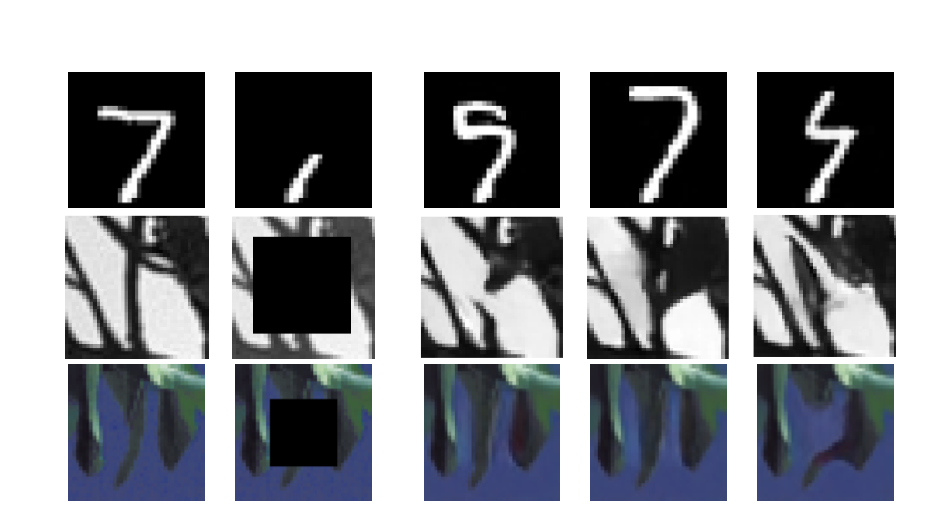
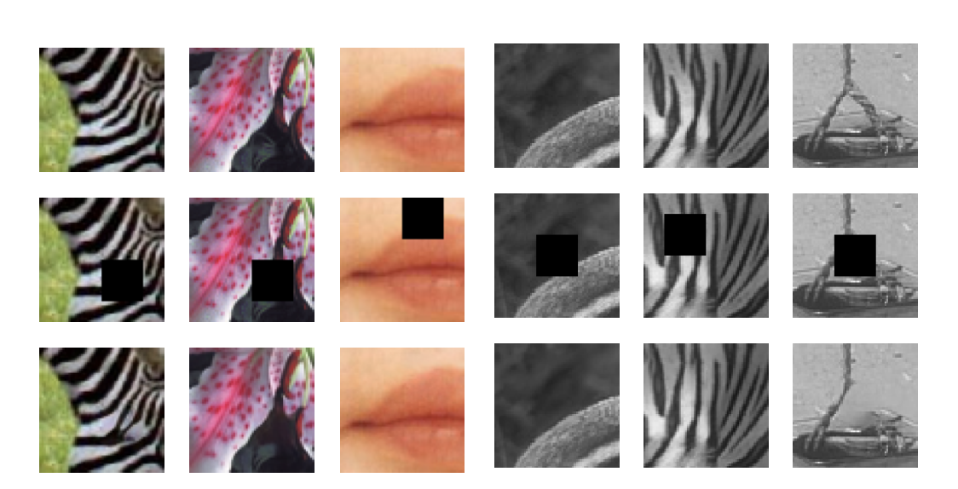
Inpainting
Description: Image inpainting is the task of reconstructing missing image parts from available known data. This method can be illustrated better with an example:
Example:
Inpainting examples generated using three BF-CNN denoisers trained on (1) MNIST, (2) Berkeley grayscale segmentation dataset (3) Berkeley color segmentation dataset.
Notes:
Left picture: First column: original images. Second column: partially measured images. Right three columns: Restored examples, with different random initializations, $y_{0}$. Each initialization results in a different restored image, corresponding to a different point on the intersection of the manifold and the constraint hyper plane.
Right picture: npainting examples. Top row: original images (x). Middle: Images corrupted with blanked region (M M T x). Bottom: Images restored using our algorithm.

Slide 9
Missing random pixels
Consider a measurement process that discards pixels at random. M is a matrix with low rank whose columns are a subset of the identity matrix corresponding to the randomly selected set of preserved pixels.

Slide 10
Spectral Super resolution
we consider a blurring operator that operates by retaining a set of low-frequency coefficient in the Fourier domain, discarding the rest.

Slide 11
Random basis
Compressive sensing provides a set of theoretical results regarding recovery of sparse signals from a small number of linear measurements

Slide 12
Spatial super resolution
Spatial image resolution explains about the pixel density in a digital image. As a result more the number of pixels more detailed visibility of information contained in the image

Slide 13

Results

Slide 14
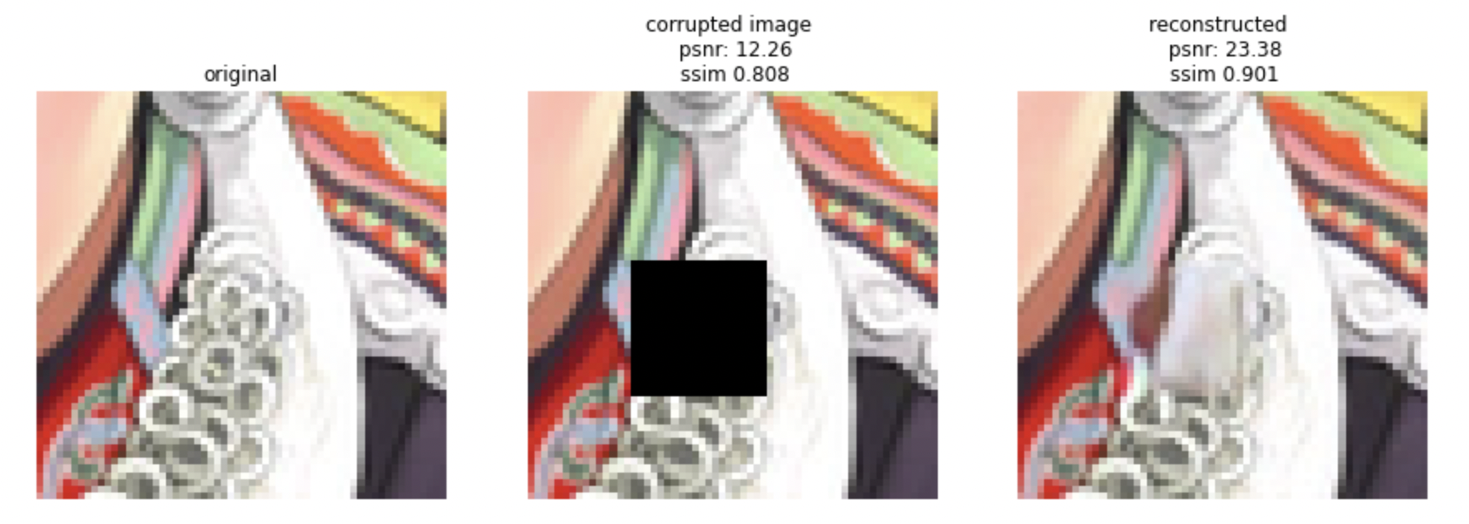
Inpainting denoiser
In solving linear inverse problems, in order to get good quality samples, beta should be small, that is lots of added noise in each iteration. This gives the algorithm the freedom to explore the space and arrive at a point on the manifold where the linear constraint is satisfied.

Slide 15
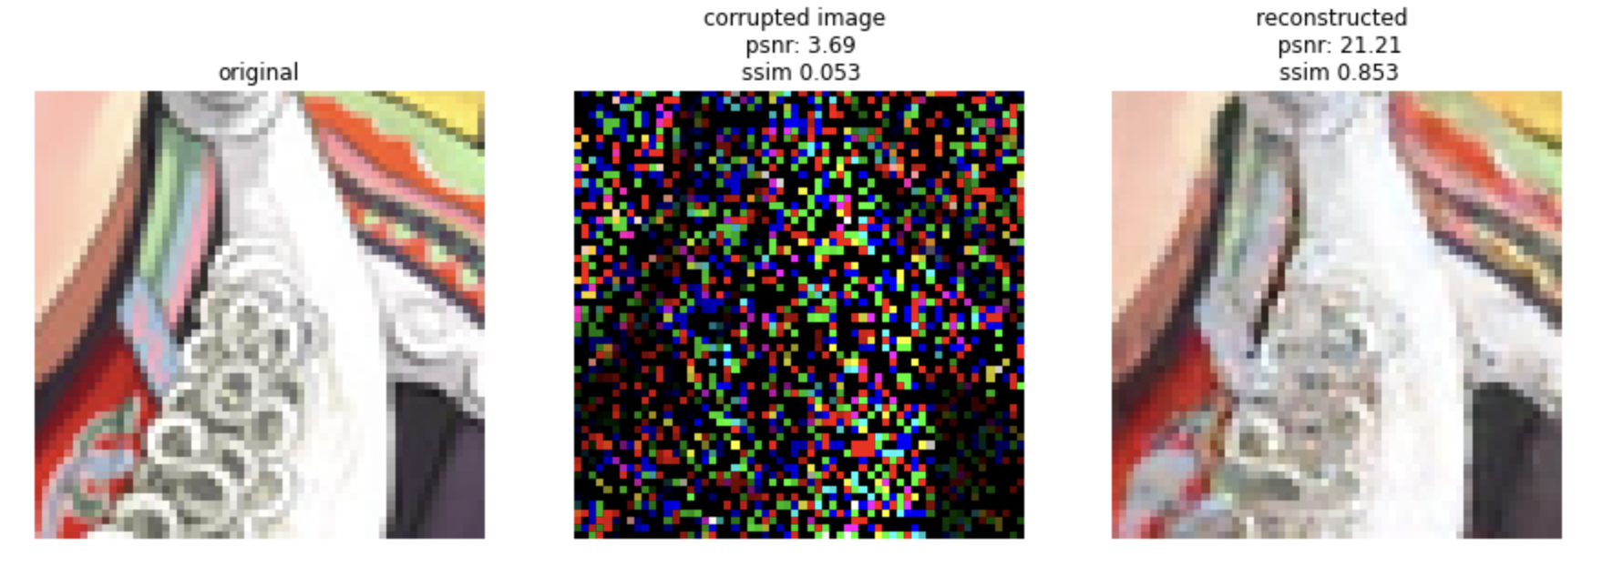
Missing random pixels denoiser
As it cab be seen despite the significant number of missing pixels, the recovered images are remarkably similar to the originals.

Slide 16
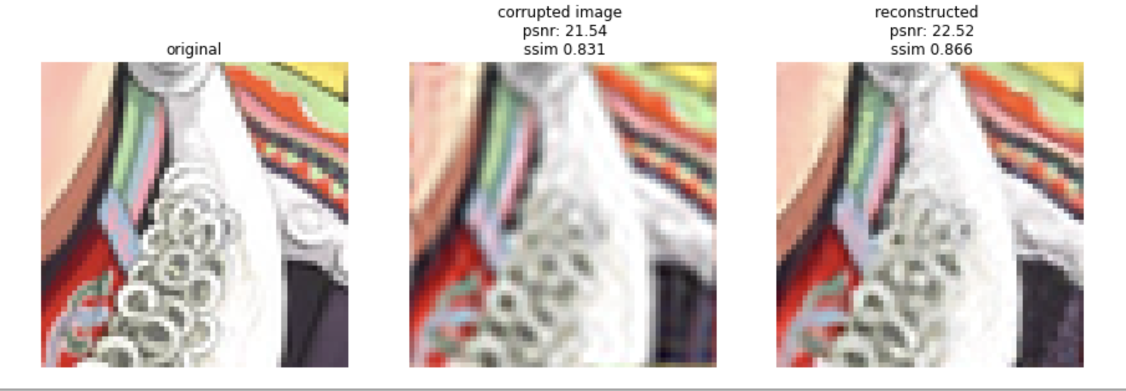
Spectral Super resolution
Project onto low frequencies (a subset of the Fourier basis)

Slide 17
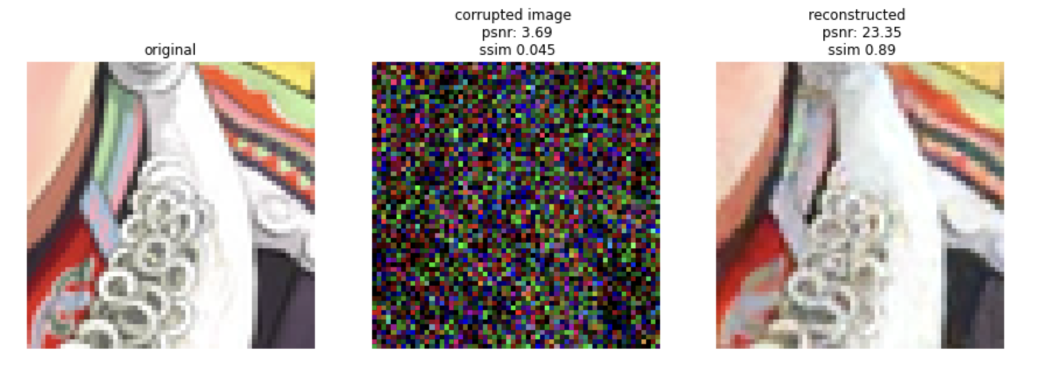
Random basis denoiser
Project image onto a random set of basis functions

Slide 18
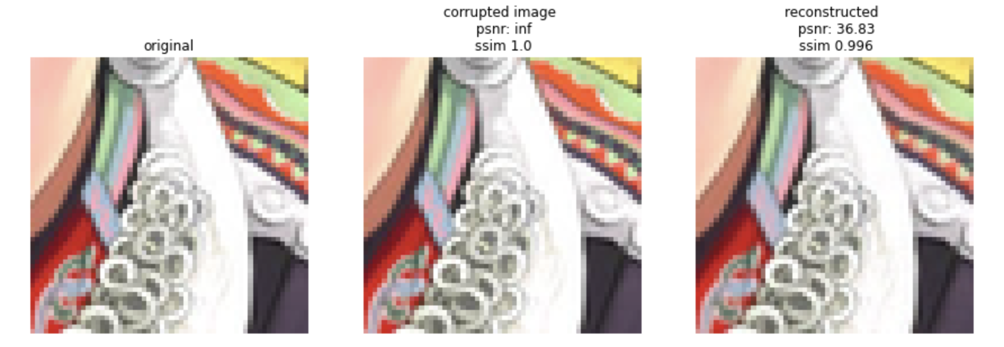
Spatial Super resolution
Subsample image by factor of s (both horizontally and vertially)

Slide 19
Conclusion
With this experiment we realize that every denoiser is efficient for specifice type of noise which is trained for,whilst for other noises they are not applicable
On the other hand, the amount of noise or corruption in the test picture is the most important component in determining the efficiency of each denoiser; the noisier the image, the less accurate the reconstructed image.

